Slide 1
E-cars & Analytics (Probable analytics use cases for E-cars charging points)
December 2020

Slide 2
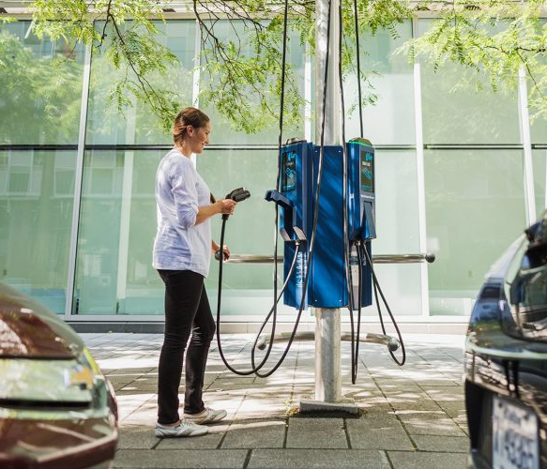
Identifying Prospective Customers
In a survey conducted in Toronto ,74% of customers were keen to adapt to EV, if given access to better charging units.
FLO, a utility company in Toronto, worked with local authorities to setup curb side charging units in residential areas.
https://thenextweb.com/shift/2020/11/10/toronto-solves-ev-charging-challenge-for-driveway-less-citizens/
ESB can follow similar approach to identify prospective customers, designing 2 different surveys targeted at different set of customers.

Slide 3
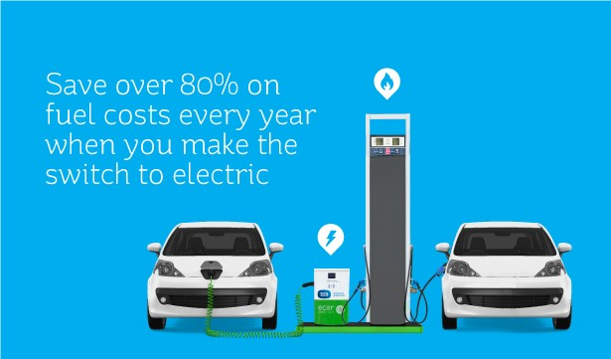
Identifying Prospective Customers – Survey 1
1st Survey:
Targeted at Electric Ireland residential customers who don’t have any home charging systems installed.
Understand reasons for not adapting to EVs.
Use the outcomes to identify prospective areas to setup curb side charging units. Perform further feasibility analysis.
Outcomes of this survey could be used to partner with EV dealers, to offer special discounts for Electric Ireland customers.

Slide 4

Identifying Prospective Customers – Survey 2
2nd Survey:
Targeted at EV car owners who use ESB’s public charging points, but aren’t Electric Ireland customers or don’t have EV home charging installed.
Understand reasons for not having EV charging unit at home.
If there is one at home, why not Electric Ireland?
Use the outcomes to understand shortcomings (if any) & generate customer specific offers to encourage to convert to Electric Ireland.
It could also help us to identify areas where charging stations could be setup.

